Slide 1
Meriam’s Trial Rules
Now that you have practiced the basics of alchemy, you’re ready to learn how to play this game

Slide 2
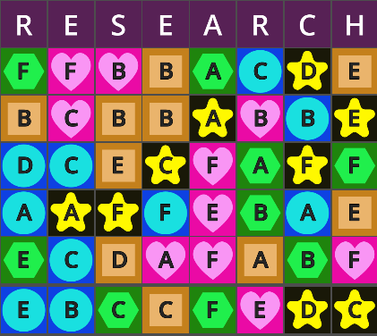
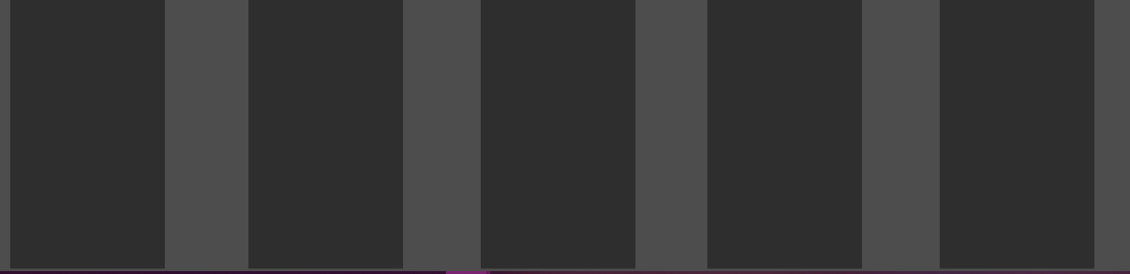

Goal
Place all tiles into active experiments
(to win there must be no tiles in research, storage or inactive experiments)
Your final setup must follow all alchemical laws

Slide 3

Research
Only tiles in the bottom row are available to be taken
After taking a tile from the bottom row, it will be replaced by the next one above it in the same column
Tiles taken from research must be placed into one of your experiments or storage
You are locked from taking new tiles if any of your experiments are unstable

Slide 4
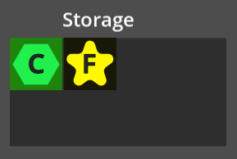
Storage
Tiles can be freely placed into or out of storage.
Storage is never subject to alchemic laws
Storage has a capacity of 8
Storage starts with 2 random tiles

Slide 5
Experiments
You have 5 experiments that can each hold any number of tiles
Tiles can be moved between experiments freely
Experiments are inactive when they have less than 3 tiles and active when they have at least 3 tiles
Inactive experiments are automatically stable
All active experiments are subject to alchemical laws
Active experiments are stable only if they do not violate any alchemical laws. If it breaks any laws, it is unstable (blocking victory and taking new tiles from research)
The laws of Alchemy apply separately to both the shapes and letters in an experiment
Each experiment is a distinct alchemical set, separate from other experiments

Slide 6
Meta Constraints
Eventually, both alchemical laws will also apply to the number of tiles each active experiment has
In other words, two active experiments can not have the same number of tiles and one experiment can not have more tiles than all the other active experiments combined
These constraints do not apply until there are at least 20 tiles in your active experiments
When meta constraints are broken, all experiments become unstable

